Slide 1
Head First
Chapter-11:
Risky Behavior
Upcode Software
Engineer Team
-2023-

Slide 2
CONTENT
What is Exception?
Exception Handling in Java
Java Exception Hierarchy
What are the Types of Exception?
Reference resource

Slide 3
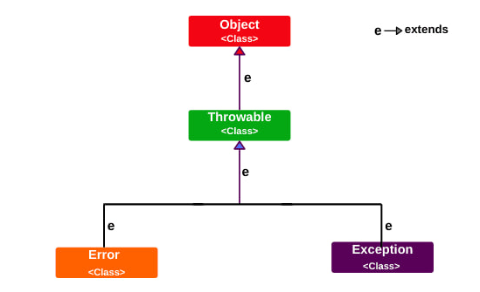
What is Exception (1/n)
In Java, Exception is an unwanted or unexpected event, which occurs during the execution of a program, i.e. at run time, that disrupts the normal flow of the program’s instructions
Exceptions can be caught and handled by the program.

Slide 4
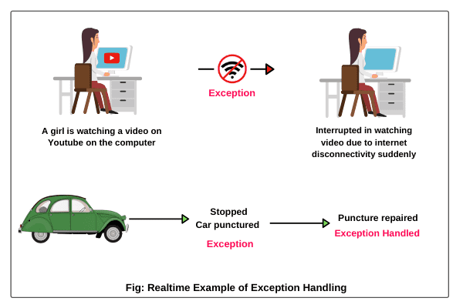
Exception Handling in Java (1/n)
Exception Handling is a mechanism to handle runtime errors
It is an object which is thrown at runtime

Slide 5
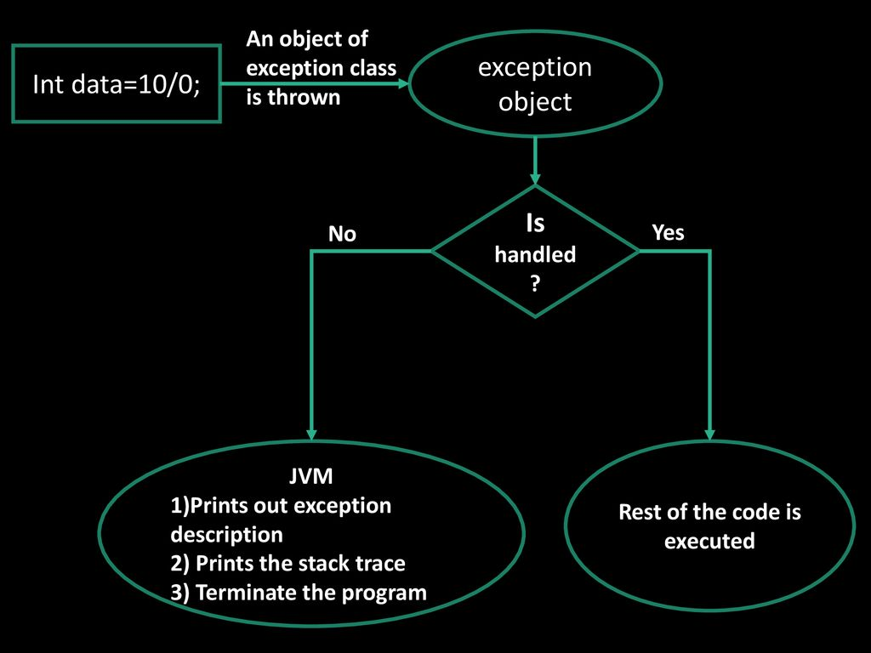
Exception Handling in Java (2/n)
Exception handling done with the exception object

Slide 6
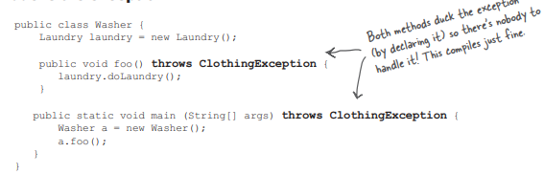
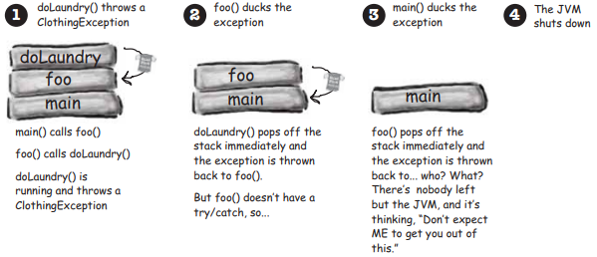
Exception Handling in Java (3/n)

Slide 7
Exception Handling in Java (3/n)
Exception Handling Terms
try - used to enclose a segment of code that may produce a exception
catch - placed directly after the try block to handle one or more exception types
finally - optional statement used after a try-catch block to run a segment of code regardless if a exception is generated

Slide 8
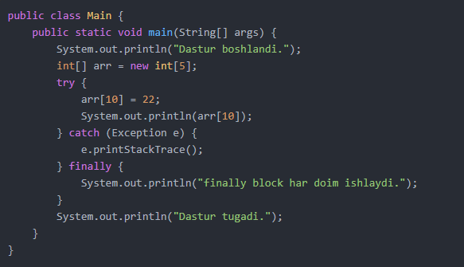
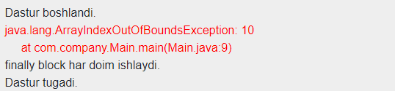
Exception Handling in Java (4/n)

Slide 9
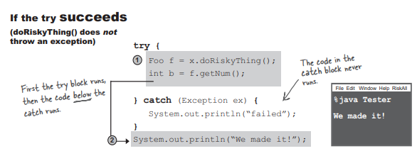
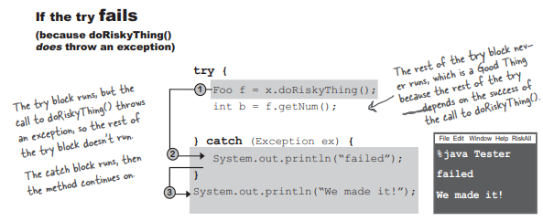
Exception Handling in Java (5/n)

Slide 10
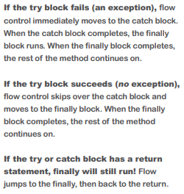
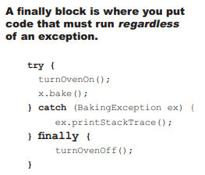
Exception Handling in Java (6/n)

Slide 11
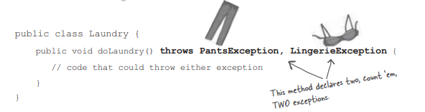
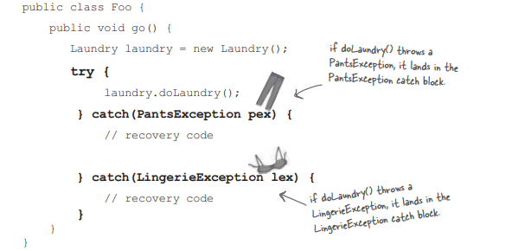
Exception Handling in Java (7/n)

Slide 12
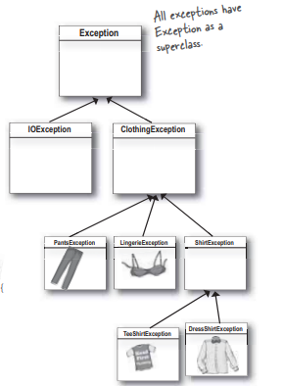
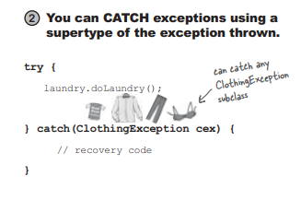
Exception Handling in Java (8/n)

Slide 13
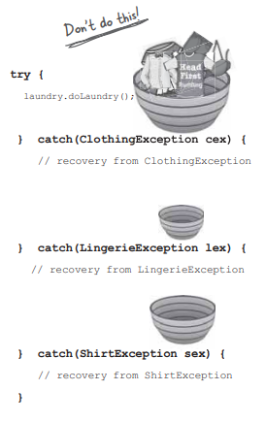
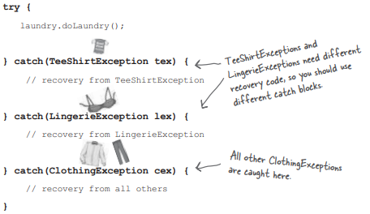
Exception Handling in Java (9/n)

Slide 14
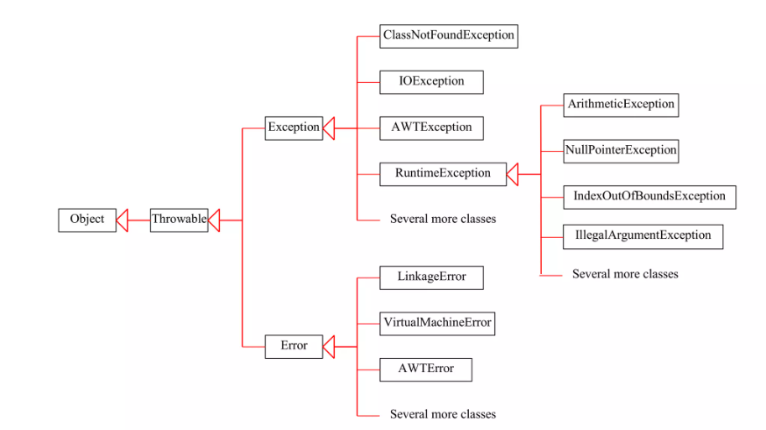
Java Exception Hierarchy(1/n)

Slide 15
Java Exception Hierarchy(2/n)
System errors are thrown by JVM and represented in the Error class. The Error class describes internal system errors. Such errors rarely occur

Slide 16
Java Exception Hierarchy(3/n)
Exception describes errors caused by your program and external circumstances. These errors can be caught and handled by your program.

Slide 17
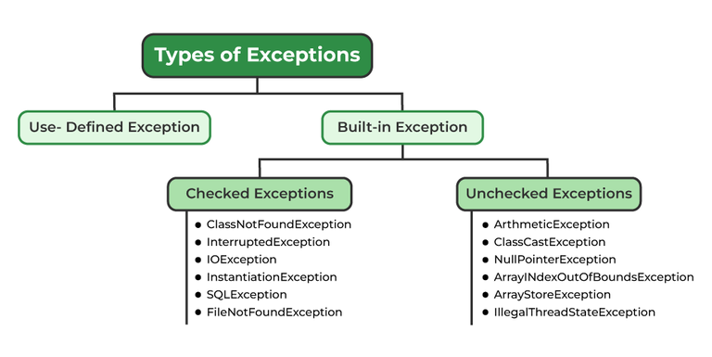
What are the Types of Exception?(1/n)
Checked exceptions: These are the exceptions that are checked by the compiler at compile time. If a method throws a checked exception, then the caller of the method must either handle the exception or declare it in the throws clause.
Unchecked exceptions: These are the exceptions that are not checked by the compiler at compile time. They include runtime exceptions and errors.

Slide 18
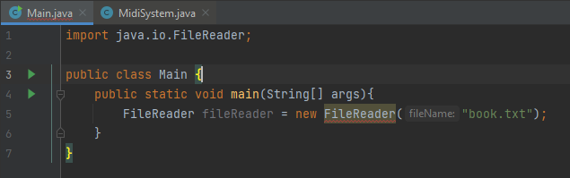
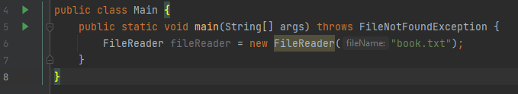
What are the Types of Exception?(2/n)
example of checked exception:

Slide 19
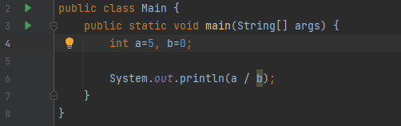
What are the Types of Exception?(3/n)
example of unchecked exception:
This code will be passed compile successfully. The compiler does not force the code to try-catch because the expression a/b may throw an Exception at runtime

Slide 20
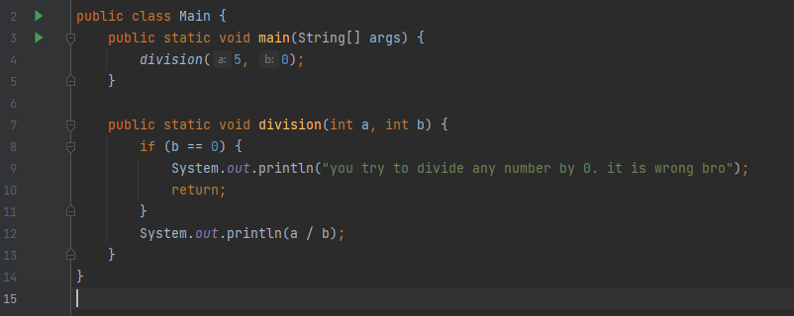
What are the Types of Exception?(4/n)
example of unchecked exception:
Unchecked Exceptions are exceptions that can be avoided. That is, the programmer can prevent errors by checking the incoming parameters while writing the code. For example, dividing a by b. A possible ArithmeticException can be avoided by checking that b is not equal to 0.

Slide 21
Reference Resource?
Head First book
Java Exception in uzbek
Exception Handling Spring Boot REST API

Slide 22
Thank you!
Presented by
Jamshid Erkinov
(jamshiderkinov19992206@gmial.com)

